Slide 1
10 Conductivity
Dr.Rani Pavithran
Assistant Professor & Head
Department of Chemistry
College of Engineering Trivandrum

Slide 2
Conductivity
Electrical energy is taken through matter in the form of electric current. In order to have electric current, charge carriers and driving force are essential. The charge carriers can be either electrons or ions.
A battery or suitable source of electric energy can be used to provide the driving force.
The substances which allows the passage of electric current through them are called conductors while those which do not allow flow of electric current are called insulators.
Conductors are of two types:1. Electronic conductors: example: metals and semiconductors.2. Electrolytic conductors: example: salt solutions, acids, molten salts

Slide 3
Conductivity
Conductivity of electrolytic conductors (10⁻³Scm⁻¹) are very low when compared with metals (10⁷Scm⁻¹). This is due to lesser number of charge carriers per unit volume and lower mobility of ions when compared with electrons.
Flow of DC current through electrolytes causes decomposition of electrolytes. While the flow of AC current has no such effects.
Electrical resistance (R) measures the obstruction to the flow of current.
Resistance of a conductor is proportional to length(l) and inversely promotional to area of cross section (a) of the conductor R α l/a
R =ρ x l/a

Slide 4
Electrical resistance
The constant of proportionality ` ρ ' is called specific resistance or resistivity of the material. Thus specific resistance is the resistance of a conductor of unit length and unit area of cross section. The unit of resistivity is ohm cm.
Electrical conductance (C) is a measure of the ease with which the current flows through a conductor or a solution. The reciprocal of resistance is called conductance.
The unit of conductance is ohm⁻¹ or mho or Siemen
C =1/R

Slide 5
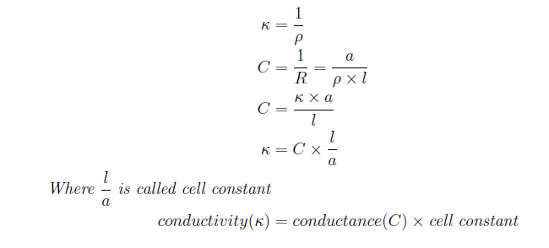
Specific conductance
Specific conductance or conductivity (κ) The reciprocal of specific resistance (ρ) is called specific conductance.
It is defined as the conductance of one cm³ of a conductor or solution held between two electrodes of 1 cm² area placed on the opposite pairs of faces of cube of edge length 1 cm.

Slide 6
Conductivity cell
A conductivity cell consists of two electrode plates coated with finely divided platinum black (to minimise polarisation effects).
These two are welded with the ends of platinum wires that are sealed through two glass tubes.
The tubes are strongly fixed such that distance between electrodes remains unaltered.
Determination of cell constant
Cell constant may be obtained by measuring `l' and `a'. But it is very difficult to measure the actual area precisely in this type of small cells.

Slide 7
Determination of cell constant
In actual practice cell constant is measured by filling the conductivity cell with a solution of known conductivity like 0.1 M KCl solution.
The conductivity (specific conductance) of 0.1M KCl solution is 0.01288 Scm⁻¹ at 298K.
Conductivity of 0.1 M KCl solution(κ) = conductance(C) x cell constant
By measuring conductance of 0.1 M KCl solution in the given cell as described below, the cell constant can be determined.

Slide 8
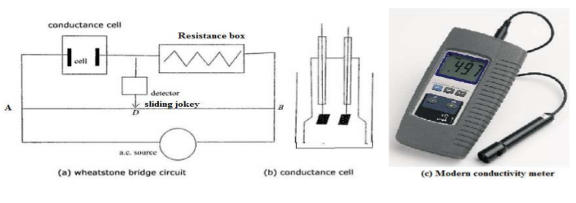
Experimental arrangement and procedure for determination of conductance
A modied form of Wheatstone bridge is used here. One arm of the bridge is connected to conductivity cell containing the test solution.
A known resistance R is taken out of the resistance box.
An alternating current source of frequency 1000-4000 Hz is connected between A and B as in g. 1.12(a) .

Slide 9
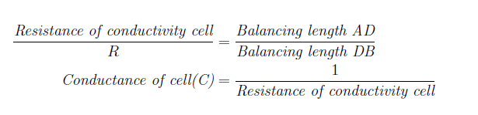
Determination of conductance
Here an alternating current is used since it can prevent electrolysis. When AC current is used galvanometer cannot be used as the null point detector.
Here the null point detector is a head phone which produces a sound corresponds to AC frequency. The bridge can be balanced by moving the sliding jockey. At balancing point the sound intensity becomes zero. From Wheatstones bridge principle at the null point,

Slide 10
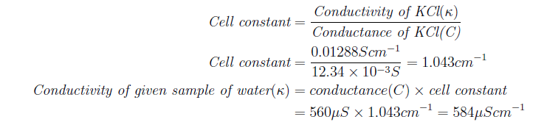
Problem: Calculate the conductivity of given sample of water at 298 K, which shows a conductance of 560µS in the given cell at 298 K. A standard solution of 0.1 M KCl shows a conductance of 12.34 mS in that cell. (Given that conductivity of 0.1 M KCl at 298 K is 0.01288Scm⁻¹)
Applications of Conductivity
1. Used for measuring salinity of water.
2. End point of an acid-base titration can be done by conductivity measurements

